Slide 1
MSDM 5003 Lecture 13 30 November 2023 Linear Regression
Reference:
Gareth James, Daniela Witten, Trevor Hastie, Robert Tibshirani, “An Introduction to Statistical Learning: with Applications in R”, 2nd Edition (Springer) Ch. 3
Christopher Bishop, “Pattern Recognition and Machine Learning”, 2006 (Springer) Ch. 3
Acknowledgement: Prof Dong XIA, instructor of MSDM 5054

Slide 2
3.0 Introduction
Formulation
General linear regression model
p = number of predictors
Goal
2

Slide 3
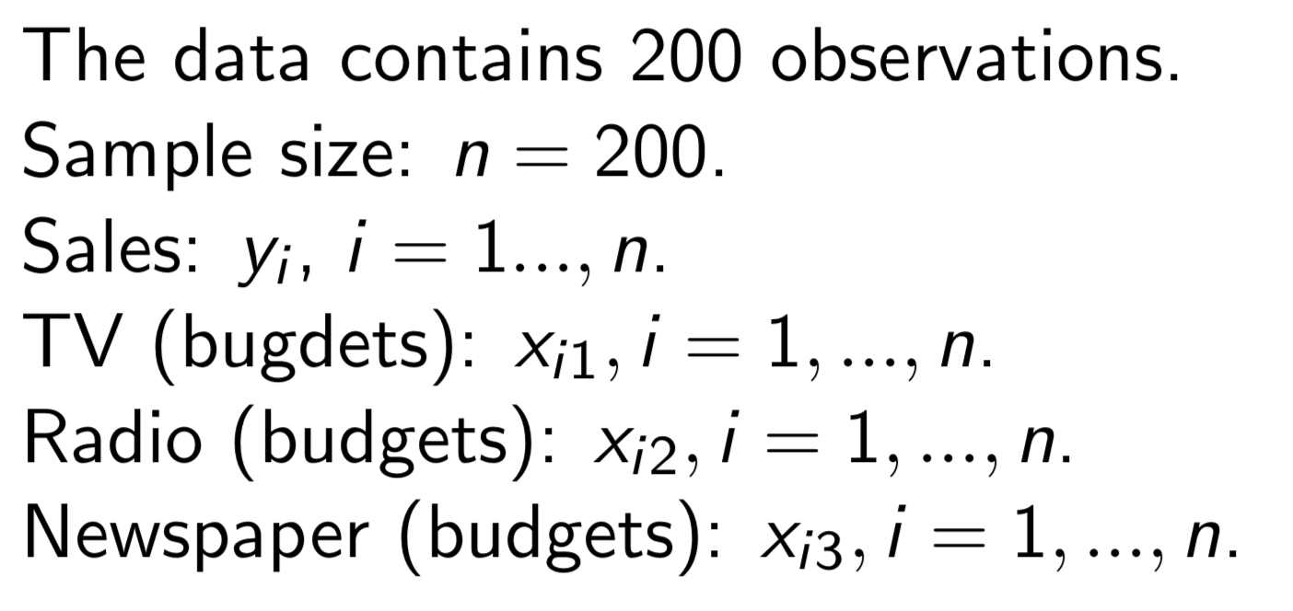
3.0 Introduction
Example: advertising data
3

Slide 4
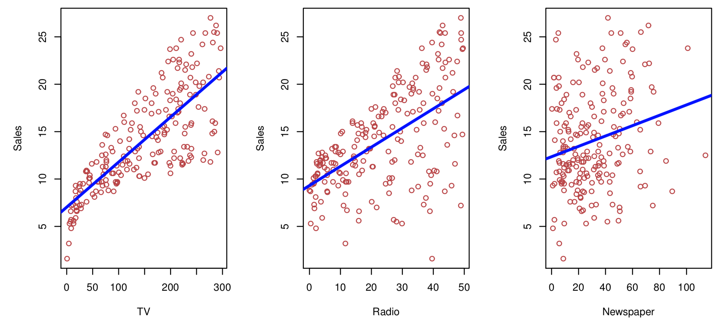
3.0 Introduction
Example: advertising data
4

Slide 5
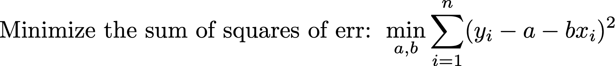
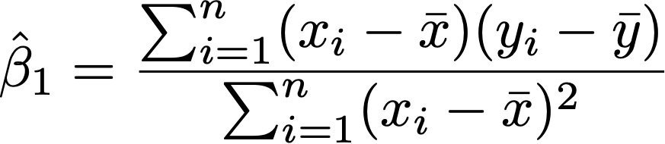

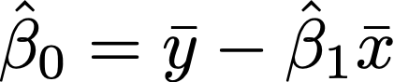
3.1 Simple Linear Regression
Simple linear regression
5

Slide 6
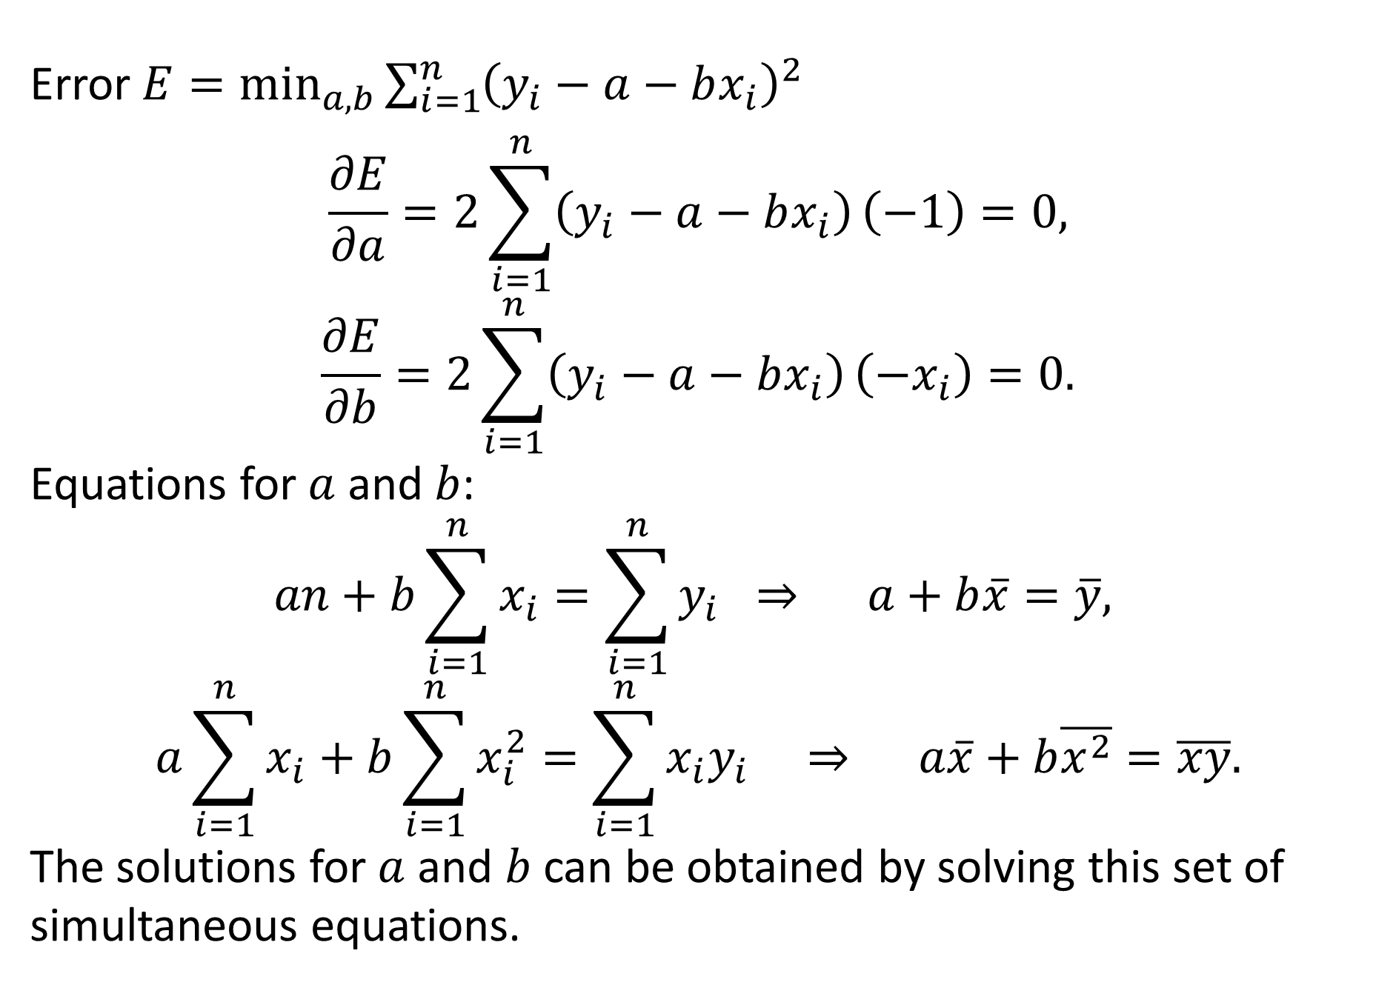

Derivation of ${\hat{β}}_{1}$ and ${\hat{β}}_{0}$
Error $E=\min_{a,b}{\sum_{i=1}^{n}{{\left(y_{i}−a−bx_{i}\right)}^{2}}}$
$$\frac{∂E}{∂a}=2\sum_{i=1}^{n}{\left(y_{i}−a−bx_{i}\right)}\left(−1\right)=0,$$
$$\frac{∂E}{∂b}=2\sum_{i=1}^{n}{\left(y_{i}−a−bx_{i}\right)}\left(−x_{i}\right)=0.$$
Equations for $a$ and $b$:
$$an+b\sum_{i=1}^{n}{x_{i}}=\sum_{i=1}^{n}{y_{i}} ⇒ a+b\overline{x}=\overline{y},$$
$$a\sum_{i=1}^{n}{x_{i}}+b\sum_{i=1}^{n}{x_{i}^{2}}=\sum_{i=1}^{n}{x_{i}y_{i}} ⇒ a\overline{x}+b\overline{x^{2}}=\overline{xy}.$$
The solutions for $a$ and $b$ can be obtained by solving this set of simultaneous equations.

Slide 7
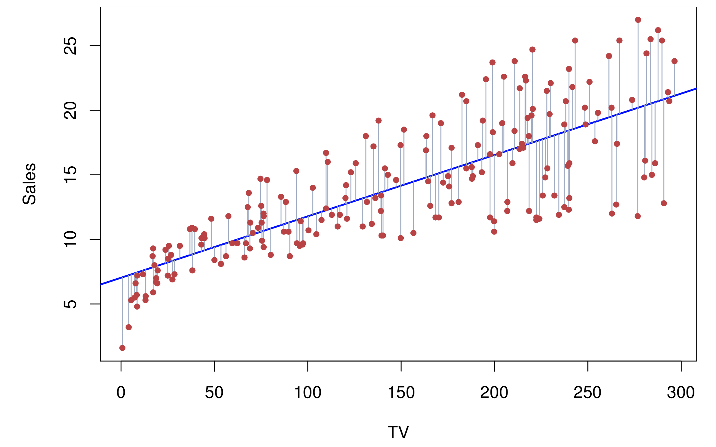
3.1 Simple Linear Regression
Example: advertising data
7

Slide 8
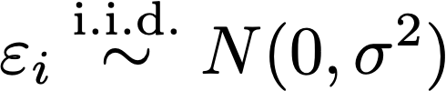
3.1 Simple Linear Regression
Statistical Inference
Goal
Assumption
The random error terms are independent and have identical normal distributions.
8

Slide 9
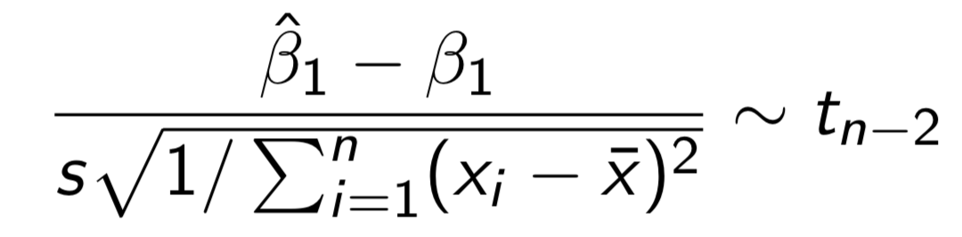
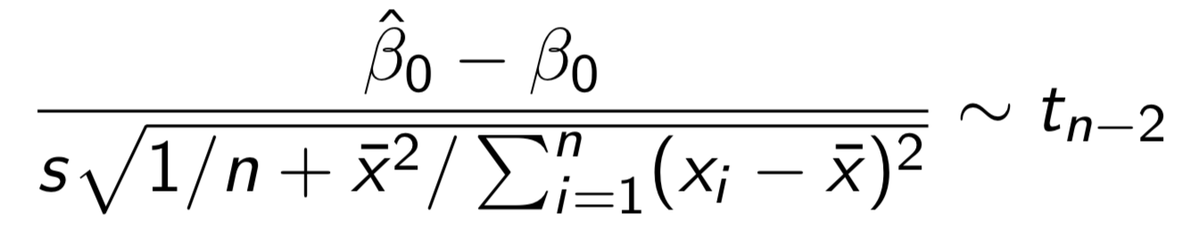
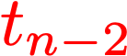
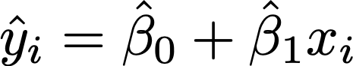
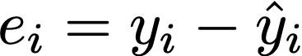
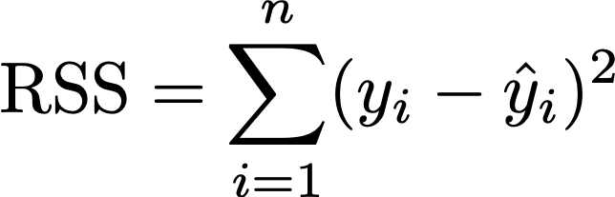
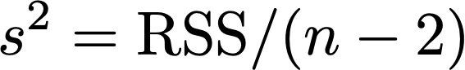
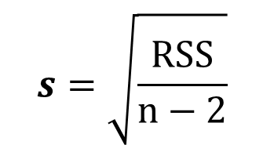
3.1 Simple Linear Regression
Statistical Inference
Theorem
This theorem is a special case of the Theorem of LSE in Section 3.4.
Student t distribution
https://en.wikipedia.org/wiki/Student%27s_t-distribution
Fitted value
Residual
Residual sum of squares
Residual standard error
$$s=\sqrt{\frac{RSS}{n−2}}$$
9

Slide 10
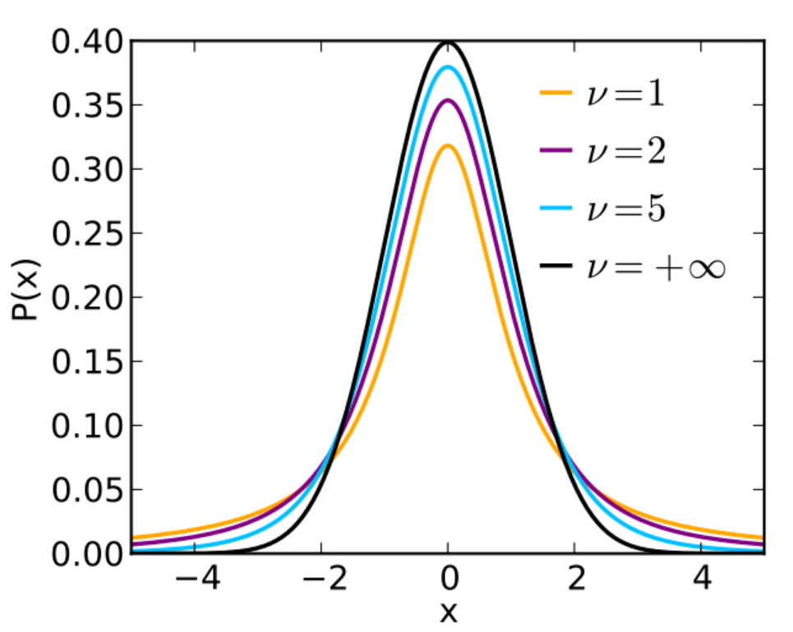
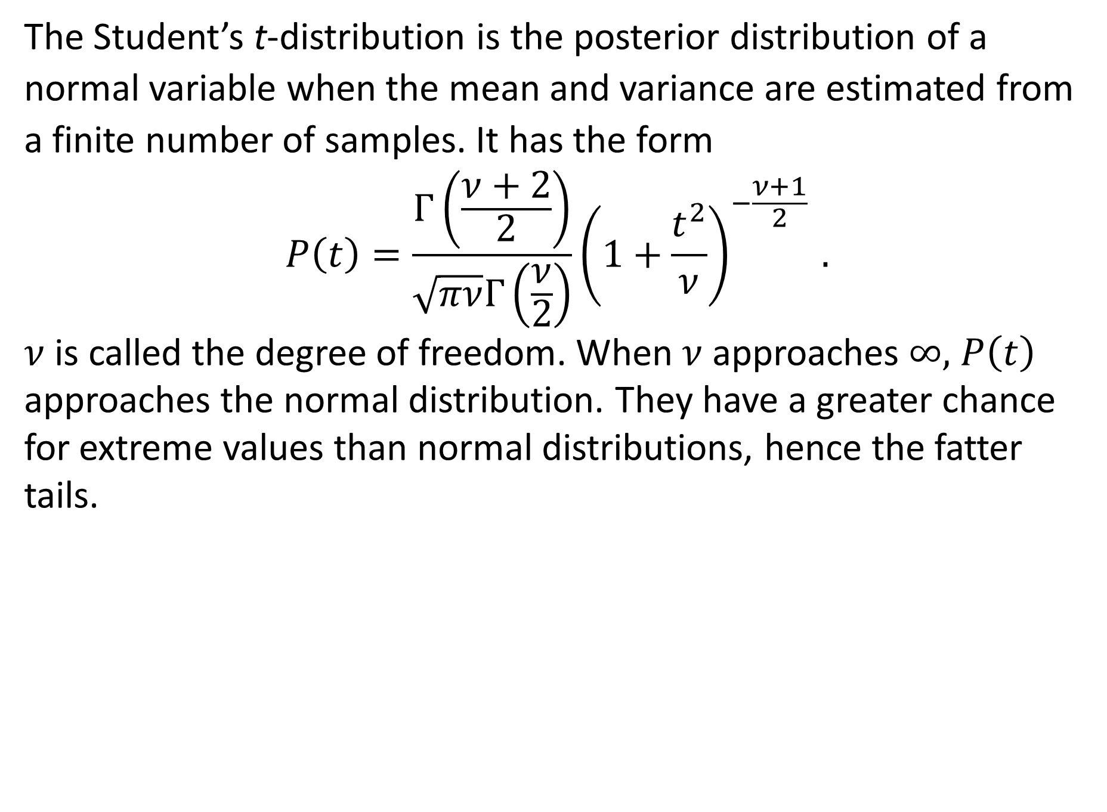
Student’s t-Distribution
The Student’s t-distribution is the posterior distribution of a normal variable when the mean and variance are estimated from a finite number of samples. It has the form
$$P\left(t\right)=\frac{Γ\left(\frac{ν+2}{2}\right)}{\sqrt{πν}Γ\left(\frac{ν}{2}\right)}{\left(1+\frac{t^{2}}{ν}\right)}^{−\frac{ν+1}{2} }.$$
$ν$ is called the degree of freedom. When $ν$ approaches $∞,$ $P\left(t\right)$ approaches the normal distribution. They have a greater chance for extreme values than normal distributions, hence the fatter tails.

Slide 11
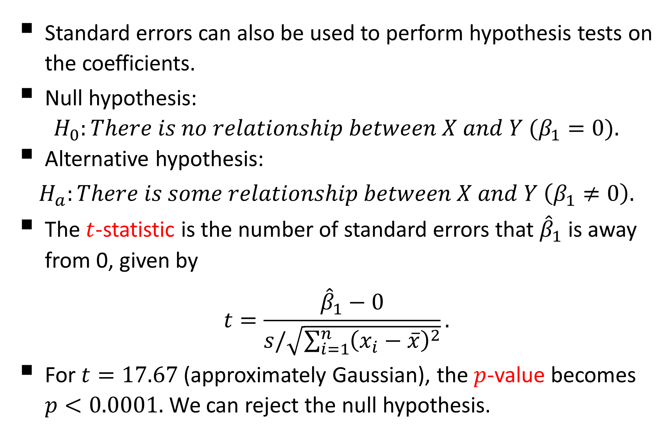
Hypothesis Tests
Standard errors can also be used to perform hypothesis tests on the coefficients.
Null hypothesis:
$$H_{0}:There is no relationship between X and Y (β_{1}=0).$$
Alternative hypothesis:
$$H_{a}:There is some relationship between X and Y \left(β_{1}≠0\right).$$
The $t$-statistic is the number of standard errors that ${\hat{β}}_{1}$ is away from 0, given by
$$t=\frac{{\hat{β}}_{1}−0}{s/\sqrt{\sum_{i=1}^{n}{{\left(x_{i}−\overline{x}\right)}^{2}}}}.$$
For $t=17.67$ (approximately Gaussian), the $p$-value becomes $p<0.0001.$ We can reject the null hypothesis.

Slide 12
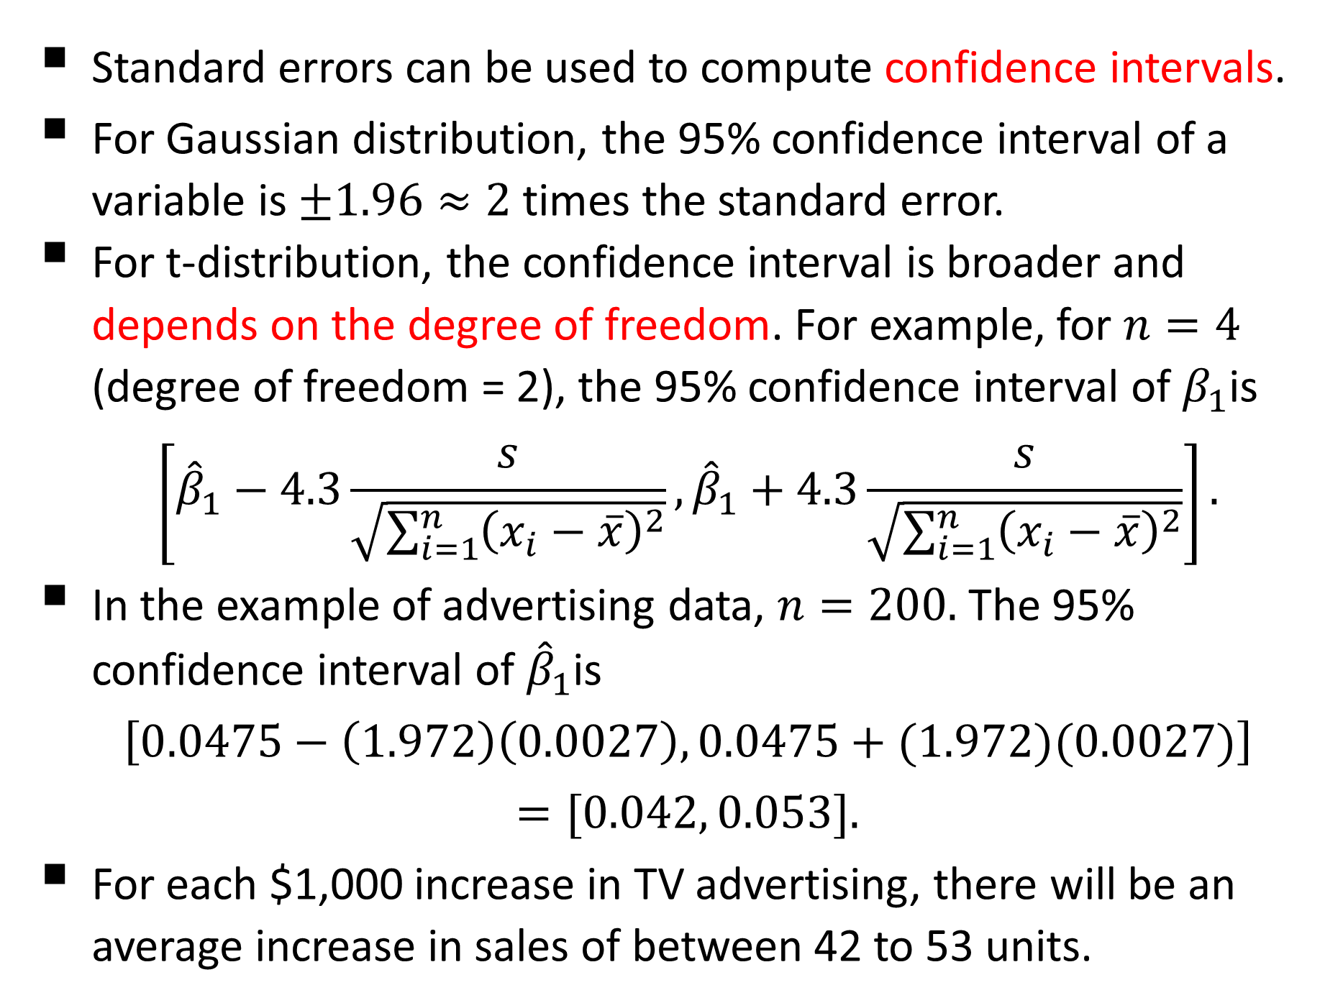
Confidence Intervals
Standard errors can be used to compute confidence intervals.
For Gaussian distribution, the 95% confidence interval of a variable is $±1.96≈2$ times the standard error.
For t-distribution, the confidence interval is broader and depends on the degree of freedom. For example, for $n=4$ (degree of freedom = 2), the 95% confidence interval of $β_{1}$is
$$\left[{\hat{β}}_{1}−4.3\frac{s}{\sqrt{\sum_{i=1}^{n}{{\left(x_{i}−\overline{x}\right)}^{2}}}},{\hat{β}}_{1}+4.3\frac{s}{\sqrt{\sum_{i=1}^{n}{{\left(x_{i}−\overline{x}\right)}^{2}}}}\right].$$
In the example of advertising data, $n=200.$ The 95% confidence interval of ${\hat{β}}_{1}$is
$$\left[0.0475−\left(1.972\right)\left(0.0027\right), 0.0475+(1.972)(0.0027)\right]$$
$$=[0.042, 0.053].$$
For each $1,000 increase in TV advertising, there will be an average increase in sales of between 42 to 53 units.

Slide 13
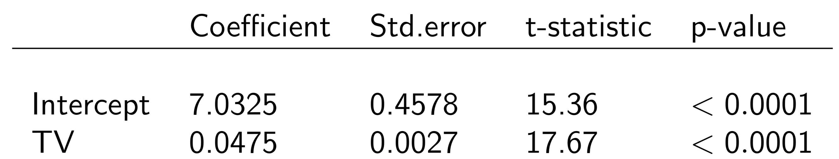

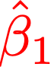
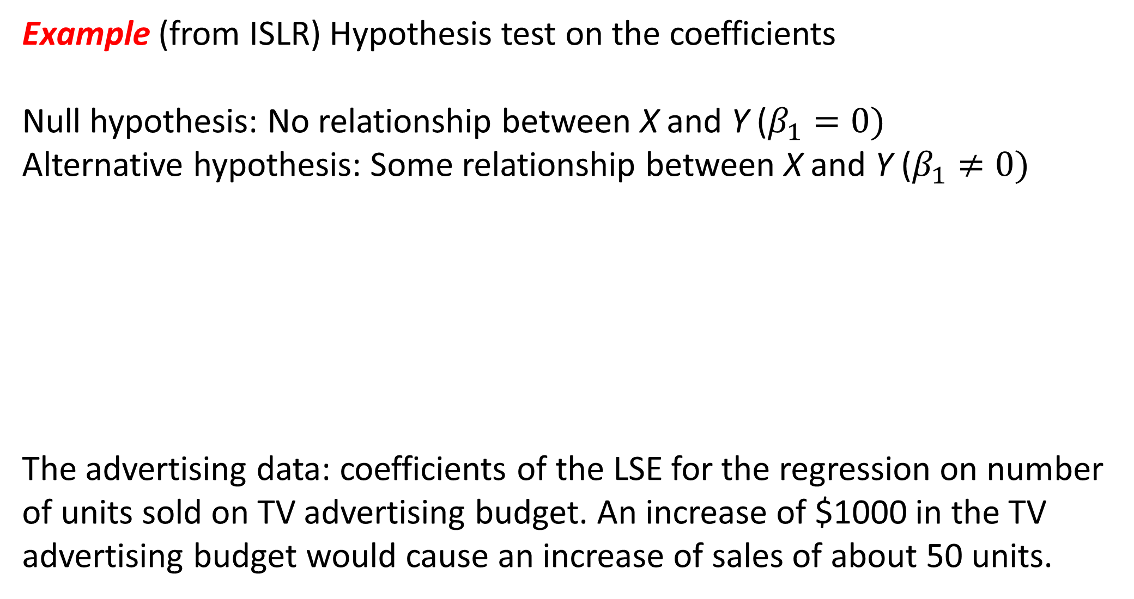
Statistical Inference
Example (from ISLR) Hypothesis test on the coefficients
Null hypothesis: No relationship between X and Y ($β_{1}=0)$
Alternative hypothesis: Some relationship between X and Y ($β_{1}≠0)$
The advertising data: coefficients of the LSE for the regression on number of units sold on TV advertising budget. An increase of $1000 in the TV advertising budget would cause an increase of sales of about 50 units.
Smaller p-value indicates that this coefficient is more likely non-zero.
13

Slide 14
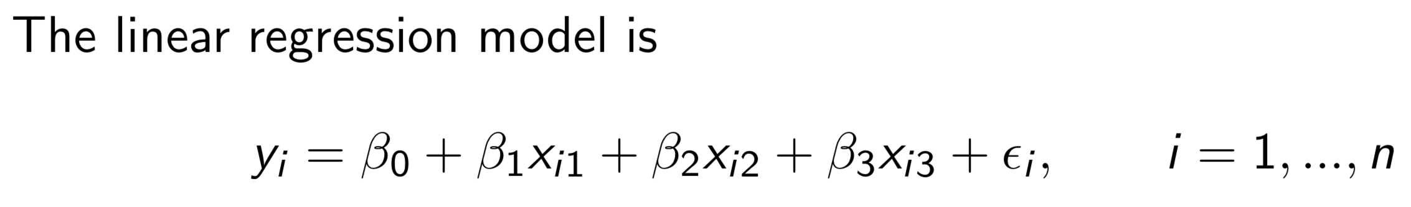
3.2 Multiple Linear Regression
General linear regression model
Example
Consider the advertising data with three covariates: TV, radio, newspapers.
The number of covariates p=3
14
Chapter 3. Linear Regression

Slide 15
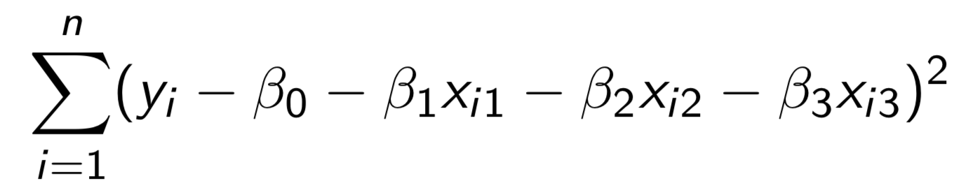
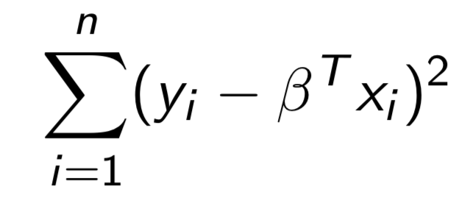

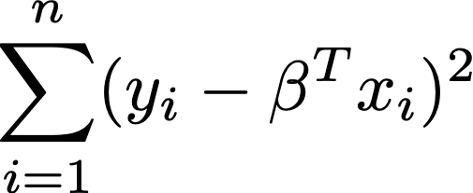
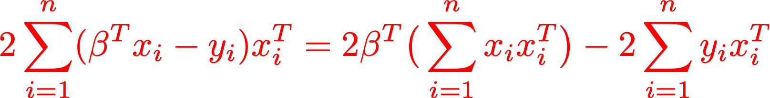

3.2 Multiple Linear Regression
Example: advertising data
Derivative (formally called gradient) of
Setting the gradient zero and solve
15

Slide 16
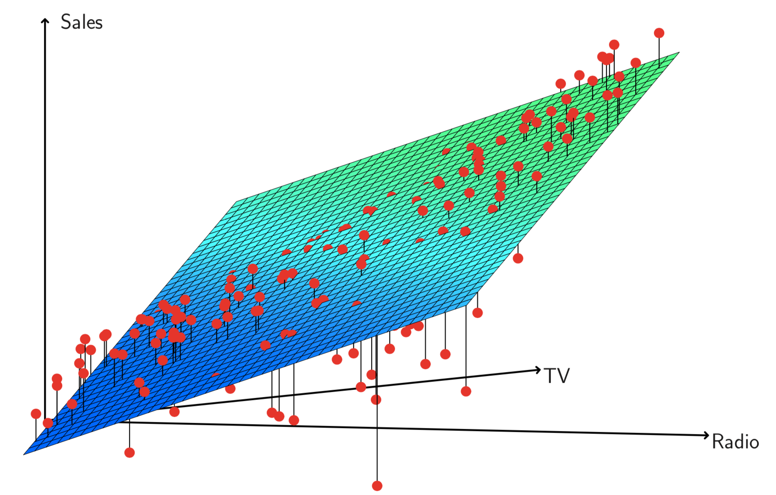
3.2 Multiple Linear Regression
Example: advertising data
16

Slide 17
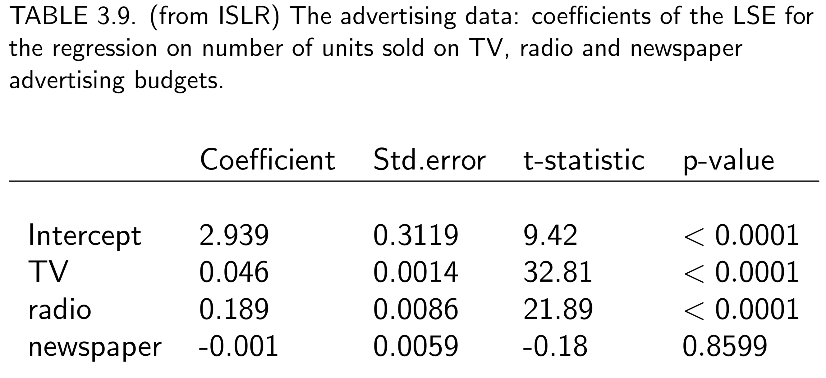
3.2 Multiple Linear Regression
Example: advertising data
Inference provided by R
17

Slide 18
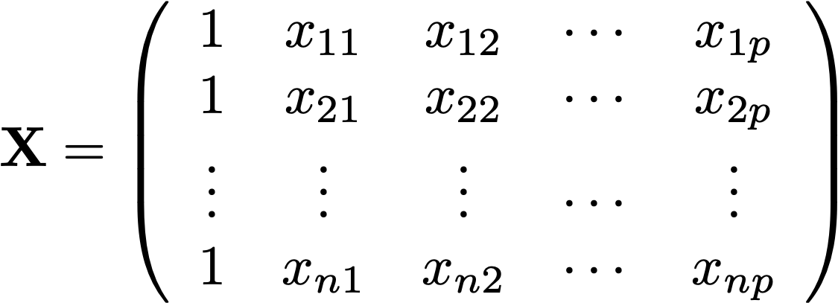
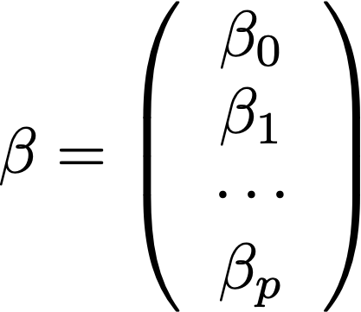
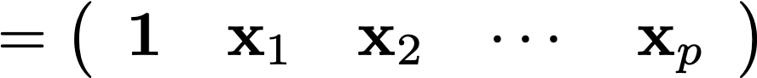
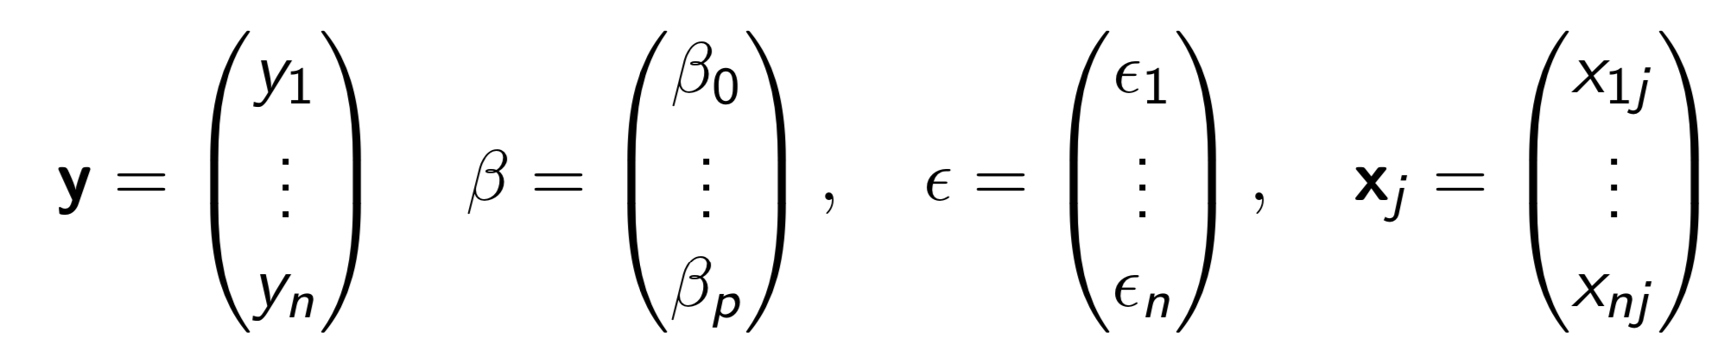
3.2 Multiple Linear Regression
Matrix Notation
In this chapter, we write
Then
18

Slide 19
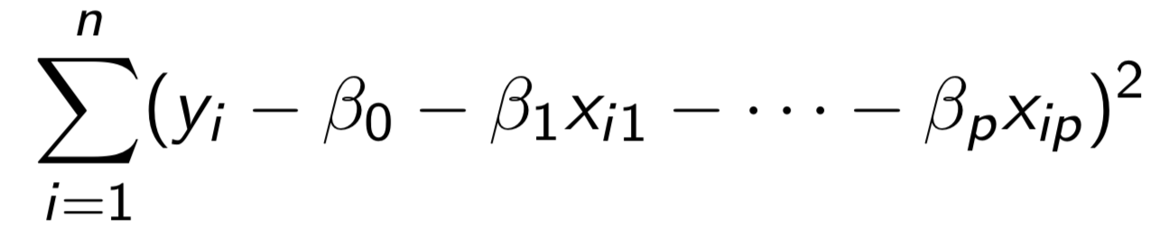
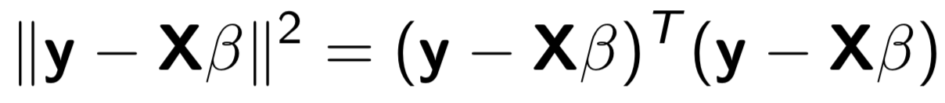
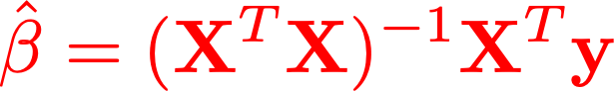
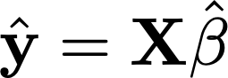
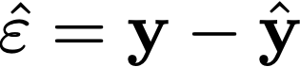
3.3 Least Squares Estimation
The least squares criterion is to minimize the sum of squares
Using matrix algebra, it is equivalently written as
By the first order optimality condition (zeroing the gradient), the LSE of is
Fitted value
Residual
19

Slide 20
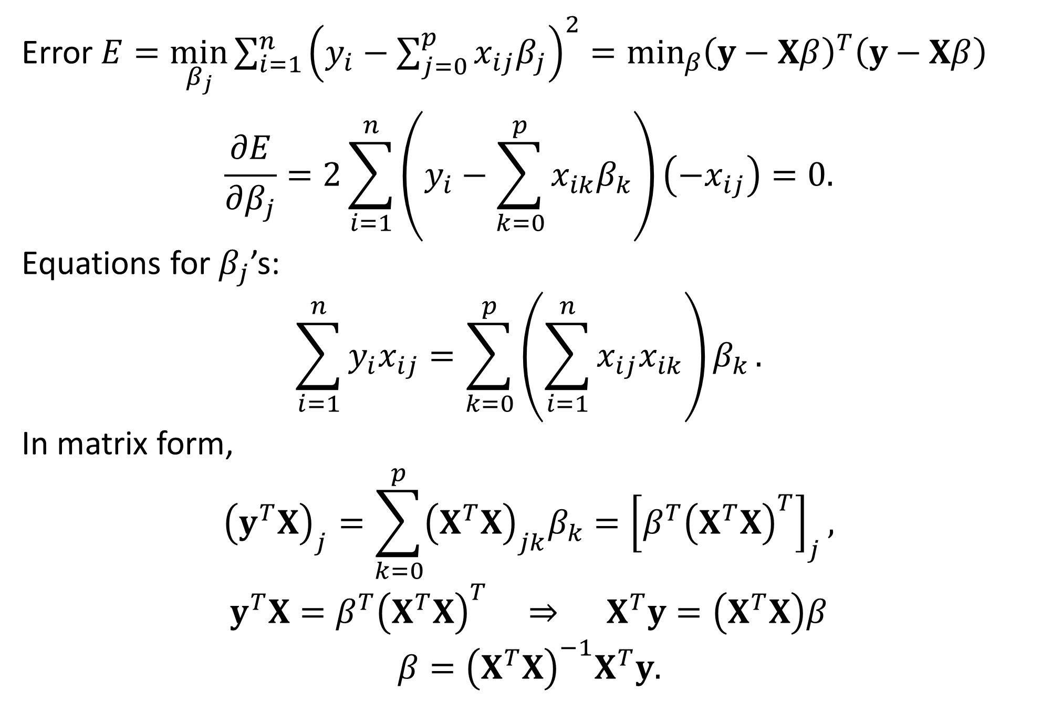

Derivation of $\hat{β}$
Error $E=\min_{β_{j}}{\sum_{i=1}^{n}{{\left(y_{i}−\sum_{j=0}^{p}{x_{ij}β_{j}}\right)}^{2}}}=\min_{β}{{\left(y−Xβ\right)}^{T}\left(y−Xβ\right) }$
$$\frac{∂E}{∂β_{j}}=2\sum_{i=1}^{n}{\left(y_{i}−\sum_{k=0}^{p}{x_{ik}β_{k}}\right)}\left(−x_{ij}\right)=0.$$
Equations for $β_{j}$’s:
$$\sum_{i=1}^{n}{y_{i}x_{ij}}=\sum_{k=0}^{p}{\left(\sum_{i=1}^{n}{x_{ij}x_{ik}}\right)β_{k}}.$$
In matrix form,
$${\left(y^{T}X\right)}_{j}=\sum_{k=0}^{p}{{\left(X^{T}X\right)}_{jk}β_{k}}={\left[β^{T}{\left(X^{T}X\right)}^{T}\right]}_{j},$$
$$y^{T}X=β^{T}{\left(X^{T}X\right)}^{T} ⇒ X^{T}y=\left(X^{T}X\right)β$$
$$β={\left(X^{T}X\right)}^{−1}X^{T}y.$$

Slide 21
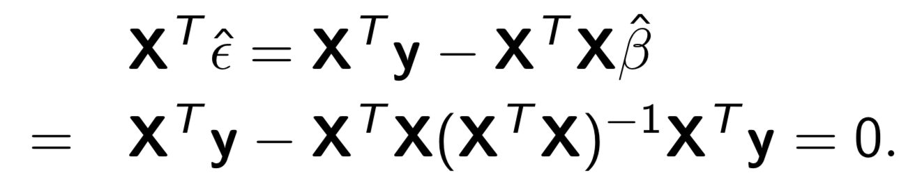

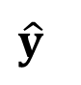
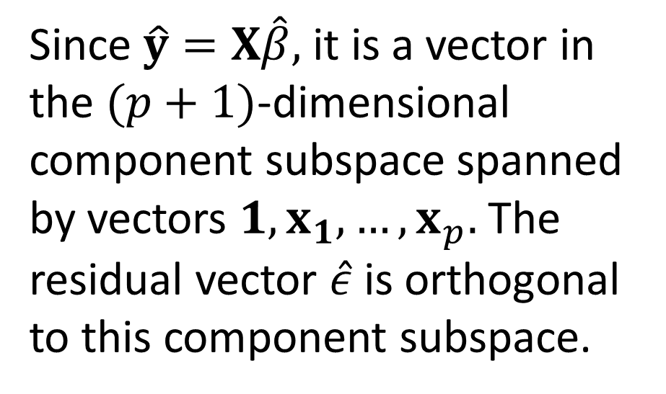
3.3 Least Squares Estimation
orthogonal
Orthogonality of residual and covariates
example 3
Example Space
y
x₁
Since $\hat{y}=X\hat{β},$ it is a vector in the $(p+1)$-dimensional component subspace spanned by vectors $1, x_{1},…, x_{p}.$ The residual vector $\hat{ε}$ is orthogonal to this component subspace.
$$\hat{ε}$$
component subspace
$$\hat{y}$$
1
example 2
example 1
21

Slide 22

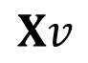
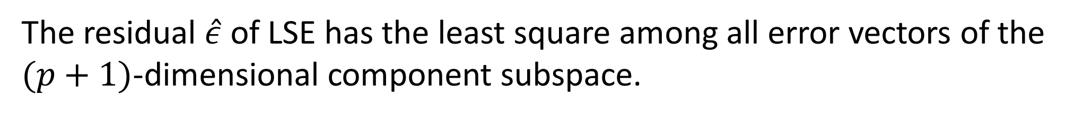
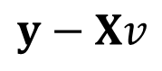
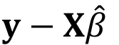
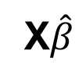
3.3 Least Squares Estimation
orthogonal
Orthogonality of residual and covariates
Least Square Property
The orthogonality of $\hat{ε}$ to the subspace spanned by $1, x_{1},…, x_{p}$ can be used to verify the least square property of $\hat{β}$.
The residual $\hat{ε}$ of LSE has the least square among all error vectors of the $(p+1)$-dimensional component subspace.
example 3
component subspace
y
x₁
$$y−Xv$$
$$y−X\hat{β}$$
X$\hat{β}$
$$Xv$$
1
example 2
example 1
22

Slide 23

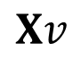
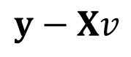



3.3 Least Squares Estimation
orthogonal
Orthogonality of residual and covariates
Proof of LSE
$$={\left\|y−X\hat{β}\right\|}^{2}−2{\left(y−X\hat{β}\right)}^{T}X\left(v−\hat{β}\right)+{\left\|X\left(v−\hat{β}\right)\right\|}^{2}$$
Note that the cross term vanishes because ${\left(y−X\hat{β}\right)}^{T}X={\hat{ε}}^{T}X=0.$ Thus
$${\left\|y−Xv\right\|}^{2}={\left\|y−X\hat{β}\right\|}^{2}+{\left\|X\left(v−\hat{β}\right)\right\|}^{2}≥{\left\|y−X\hat{β}\right\|}^{2}.$$
example 3
component subspace
y
x₁
$$y−Xv$$
$$y−X\hat{β}$$
X$\hat{β}$
$$Xv$$
1
example 2
example 1
23

Slide 24





$$y−\hat{y}$$
3.3 Least Squares Estimation
orthogonal
Orthogonality of residual and fitted values
The fitted values are orthogonal to the residuals, i.e., $\hat{y}$ is orthogonal to $y−\hat{y}$ or
$${\hat{y}}^{T}\left(y−\hat{y}\right)=0.$$
This implies
$${\left\|y\right\|}^{2}={\left\|\hat{y}\right\|}^{2}+{\left\|y−\hat{y}\right\|}^{2},$$
resembling the Pythagorean theorem.
example 3
x₁
y
$$y−\hat{y}$$
component subspace
$$\hat{y}$$
1
example 2
example 1
24

Slide 25


Derivation of ${\hat{y}}^{T}\left(y−\hat{y}\right)=0$
Since $\hat{y}=X\hat{β}$ and $y−\hat{y}=\hat{ε},$
$${\hat{y}}^{T}\left(y−\hat{y}\right)={(X\hat{β})}^{T}\hat{ε}={\hat{β}}^{T}(X^{T}\hat{ε}).$$
We have already proved that $X^{T}\hat{ε}=0$. Therefore
$${\hat{y}}^{T}\left(y−\hat{y}\right)=0.$$

Slide 26

3.4 Statistical Properties of LSE
Model assumptions
General linear regression model
Assumptions
26
Chapter 3. Linear Regression

Slide 27


3.4 Statistical Properties of LSE
Theorem of LSE
27

Slide 28


Theorem of LSE for $p=1$
$$X=\left(\begin{matrix}1 & x_{1} \\ ⋮ & ⋮ \\ 1 & x_{n}\end{matrix}\right),$$
$$X^{T}X=\left(\begin{matrix}1 & ⋯ & 1 \\ x_{1} & ⋯ & x_{n}\end{matrix}\right)\left(\begin{matrix}1 & x_{1} \\ ⋮ & ⋮ \\ 1 & x_{n}\end{matrix}\right)=\left(\begin{matrix}n & \sum_{i=1}^{n}{x_{i}} \\ \sum_{i=1}^{n}{x_{i}} & \sum_{i=1}^{n}{x_{i}^{2}}\end{matrix}\right)=n\left(\begin{matrix}1 & \overline{x} \\ \overline{x} & \overline{x^{2}}\end{matrix}\right).$$
$${\left(X^{T}X\right)}^{−1}=\frac{1}{n\left(\overline{x^{2}}−{\overline{x}}^{2}\right)}\left(\begin{matrix}\overline{x^{2}} & −\overline{x} \\ −\overline{x} & 1\end{matrix}\right),$$
$$c_{00}=\frac{\overline{x^{2}}}{\sum_{i=1}^{n}{{\left(x_{i}−\overline{x}\right)}^{2}}}=\frac{1}{n}+\frac{{\overline{x}}^{2}}{\sum_{i=1}^{n}{{\left(x_{i}−\overline{x}\right)}^{2}}}, c_{11}=\frac{1}{\sum_{i=1}^{n}{{\left(x_{i}−\overline{x}\right)}^{2}}}.$$
$$Therefore, \frac{{\hat{β}}_{j}−β_{j}}{s\sqrt{c_{jj}}}\sim t_{n−2} as proposed in Section 3.1.$$

Slide 29

3.4 Statistical Properties of LSE
Confidence intervals of parameters
29

Slide 30




3.4 Statistical Properties of LSE
Confidence intervals of mean response
Prediction interval
30

Slide 31


Theorem of Residual
Chi-squared distribution
The $χ^{2}$-distribution is the distribution of a sum of the squares of $k$ independent standard normal random variables.

Slide 32




3.4 Statistical Properties of LSE
F distribution
$F_{d_{1},d_{2}}$is the distribution of
$$X=\frac{S_{1}/d_{1}}{S_{2}/d_{2}}$$
where $S_{1}$ and $S_{2}$ are independent random variables with $χ^{2}$- distributions with respective degrees of freedom $d_{1}$ and $d_{2}$.
32

Slide 33



3.5 Analysis of Variances (ANOVA)
Decomposition of variances
33

Slide 34


$R^{2}$ Statistic
$SS_{total}={\left\|y−\overline{y}\right\|}^{2}$= inherent amount of variability before the regression is performed
$SS_{error}={\left\|y−\hat{y}\right\|}^{2}$= amount of variability that is left unexplained after performing the regression
$SS_{reg}=SS_{total}−SS_{error}$= ${\left\|\hat{y}−\overline{y}\right\|}^{2}$= amount of variability that is explained (or removed) by performing the regression
$$R^{2}=\frac{SS_{total}−SS_{error}}{SS_{total}}=\frac{SS_{reg }}{SS_{total}}=\frac{{\left\|\hat{y}−\overline{y}\right\|}^{2}}{{\left\|y−\overline{y}\right\|}^{2}}.$$
$R^{2}$ measures the ability of the regression to reduce the variability in the data.
$R^{2}$ close to 1 ⇒ a large proportion of the variability in the response is explained by the regression.

Slide 35


$R^{2}$ Statistic for single linear regression
In simple linear regression,
$$\hat{y}=mx+b where m=\frac{\left\langle xy\right\rangle −⟨x⟩⟨y⟩}{\left\langle x^{2}\right\rangle −{\left\langle x\right\rangle }^{2}} and b=\left\langle y\right\rangle −m\left\langle x\right\rangle .$$
Therefore,
$$\frac{SS_{error}}{n}=\left\langle {\left(\hat{y}−y\right)}^{2}\right\rangle =\left\langle {\left(mx+b−y\right)}^{2}\right\rangle$$
$$=\left\langle {\left[m\left(x−\left\langle x\right\rangle \right)−\left(y−\left\langle y\right\rangle \right)\right]}^{2}\right\rangle$$
$$=m^{2}\left(\left\langle x^{2}\right\rangle −{\left\langle x\right\rangle }^{2}\right)−2m\left(\left\langle xy\right\rangle −\left\langle x\right\rangle \left\langle y\right\rangle \right)+\left(\left\langle y^{2}\right\rangle −{\left\langle y\right\rangle }^{2}\right)$$
$$=−\frac{{\left(\left\langle xy\right\rangle −\left\langle x\right\rangle \left\langle y\right\rangle \right)}^{2}}{\left\langle x^{2}\right\rangle −{\left\langle x\right\rangle }^{2}}+\left\langle y^{2}\right\rangle −{\left\langle y\right\rangle }^{2}.$$
$$\frac{SS_{total}}{n}=\left\langle y^{2}\right\rangle −{\left\langle y\right\rangle }^{2}.$$
$$R^{2}=\frac{{\left(\left\langle xy\right\rangle −\left\langle x\right\rangle \left\langle y\right\rangle \right)}^{2}}{\left[\left\langle x^{2}\right\rangle −{\left\langle x\right\rangle }^{2}\right]\left[\left\langle y^{2}\right\rangle −{\left\langle y\right\rangle }^{2}\right]}=Cov(x, y).$$
However, the concept of covariance cannot be extended to multiple linear regression.

Slide 36

3.5 Analysis of Variances (ANOVA)
ANOVA table
36

Slide 37

Hypothesis Testing in ANOVA
Is there relation between covariates and response ? (ANOVA)
Null hypothesis:
$$H_{0}:β_{1}=β_{2}=⋯=β_{p}=0,$$
versus the alternative
$$H_{a}:at least one β_{j} is nonzero.$$
This hypothesis test is performed by computing the $F$-statistic,
$$F=\frac{MS_{reg}}{MS_{error}}=\frac{SS_{reg}/p}{SS_{error}/(n−p−1)}.$$
If $H_{0}$is true, one would expect the $F$-statistic to be close to 1.
If $H_{a}$ is true, we expect $F>1.$
If $F$ is large, its probability in the $F$-distribution will be small, and the null hypothesis can be rejected.
The $p$-value is calculated by the probability that the $F$-statistic is greater than the observed value.

Slide 38


3.5 Analysis of Variances (ANOVA)
More general tests of linear model
We have shown how to test
i.e.,
Rationale of ANOVA
38

Slide 39

3.5 Analysis of Variances (ANOVA)
More general tests of linear model
What if we want to test the case that a particular set of $q$ of the coefficients are zero? This corresponds to the null hypothesis
$$H_{0}:β_{p−q+1}=β_{p−q+2}=⋯=β_{p}=0.$$
In this case we fit a model that uses all variables except those last $q$. Suppose the residual sum of squares for that model is SS₀. Then the appropriate F-statistic is
$$F=\frac{({SS}_{0}−{SS}_{error})/q}{{SS}_{error}/(n−p−1)}.$$
39

Slide 40
ANOVA in Python
See ONE-WAY ANOVA in PYTHON FOR DATA SCIENCE for both an example and Python program:
pythonfordatascience.org/anova-python/
The package for one-way ANOVA can be imported from scipy.stats or statsmodels.api
Also, “Anova: Single Factor” is also available in Excel.

Slide 41
Assumption Check for ANOVA
The following assumptions need to be met in order for the results of ANOVA to be considered valid:
Independence of observations (e.g. an individual can only belong to one group)
Normality
Equality (homogeneity) of variances (homoscedasticity)

Slide 42

Normality
The residuals are assumed to follow normal distributions.
A Quantile-Quantile plot (Q-Q Plot) can be used to test whether a distribution is normal:
Generate a sample of equal number of data points following a normal distribution with the same mean and variance.
Rank the data points of both the normally distributed sample and the residual sample and plot against each other.
The data points should lie on the diagonal line if the residual sample is normally distributed.
Other method: Shapiro-Wilk test
(see scipy.stats)

Slide 43

Homoscedasticity
Heteroscedasticity can cause the estimate being not the optimal one .
May be fixed by weighted least squares estimation.
Use scatter plot of residuals against the fitted values to check the
heteroscedasticity (the variance of the errors are not equal).
43

Slide 44

Homoscedasticity
Heteroscedasticity can be identified by the presence of a funnel shape in the residual plot. (left figure)
May be fixed by transforming using a concave function such as logY or sqrt(Y). (right figure)
44

Slide 45
3.6 Superiority of LSE
Why is LSE good ?
Easy computation
Consistency
https://en.wikipedia.org/wiki/Consistent_estimator
Efficiency
https://en.wikipedia.org/wiki/Efficient_estimator
45

Slide 46

Best Linear Unbiased Estimators
Suppose a set of examples is generated by the unobservable parameters $β_{j}$according to
$$y_{i}=\sum_{j=1}^{p}{β_{j}x_{ij}}+ε_{i} ∀i=1, 2, …, n.$$
A linear estimator of $β_{j}$ is a linear combination
$${\tilde{β}}_{j}=a_{1j}y_{1}+⋯+a_{nj}y_{n}.$$
In matrix form, $\tilde{β}=Ay.$
The estimator is unbiased if and only if $E\left({\tilde{β}}_{j}\right)=β_{j}.$
The best linear unbiased estimator (BLUE) is one with the smallest mean squared error among all linear estimators. This is equivalent to $Var\left(\tilde{β}\right)−Var(\hat{β})$ is positive semi-definite for every other linear unbiased estimator $\tilde{β}$.

Slide 47

3.6 Superiority of LSE
Theorem
47

Slide 48

3.6 Superiority of LSE
Proof of Gauss-Markov Theorem
The data generated by the teacher is given by $E\left(y\right)=Xβ.$
The LSE is unbiased because
$$E\left[{\left(X^{T}X\right)}^{−1}X^{T}y\right]={\left(X^{T}X\right)}^{−1}X^{T}Xβ=β.$$
For an arbitrary unbiased linear estimator $\tilde{β}=Ay$, we write $A={\left(X^{T}X\right)}^{−1}X^{T}+D$. Then
$$E\left(\tilde{β}\right)=E\left[{\left(X^{T}X\right)}^{−1}X^{T}y+Dy\right]={\left(X^{T}X\right)}^{−1}X^{T}Xβ+DXβ$$
$$=β+DXβ=β.$$
This implies $DX=0$.
48

Slide 49

3.6 Superiority of LSE
Proof of Gauss-Markov Theorem (cont’d)
$$Var\left(\tilde{β}\right)=Var\left(Ay\right)=AVar\left(y\right)A^{T}=σ^{2}AA^{T}$$
$$=σ^{2}\left[{\left(X^{T}X\right)}^{−1}X^{T}+D\right]{\left[{\left(X^{T}X\right)}^{−1}X^{T}+D\right]}^{T}$$
$$=σ^{2}{\left(X^{T}X\right)}^{−1}+σ^{2}{\left(X^{T}X\right)}^{−1}X^{T}D^{T}+DX{\left(X^{T}X\right)}^{−1}+σ^{2}DD^{T}$$
Since $DX=0$, the cross terms vanish. Therefore,
$$Var\left(\tilde{β}\right)=σ^{2}{\left(X^{T}X\right)}^{−1}+σ^{2}DD^{T}=Var\left(\hat{β}\right)+σ^{2}DD^{T}.$$
Since $DD^{T}$ is positive semidefinite, $\hat{β}$ has the smallest variance.
49

